Slide 1
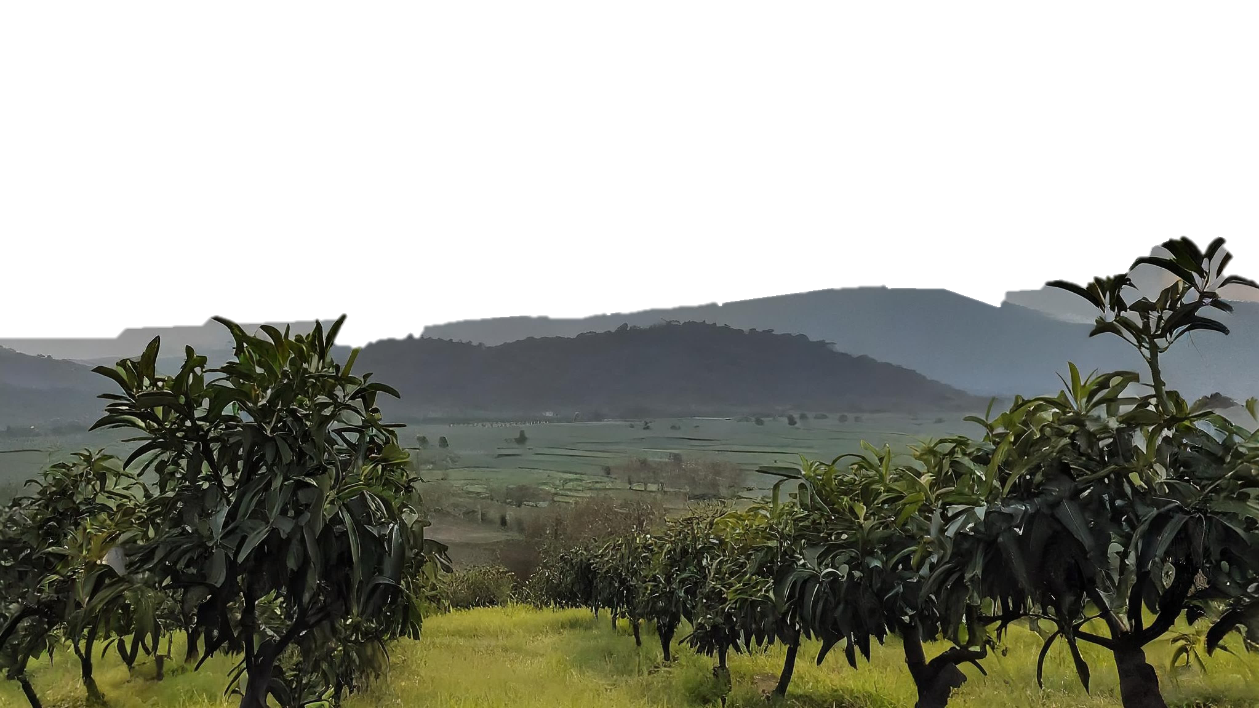
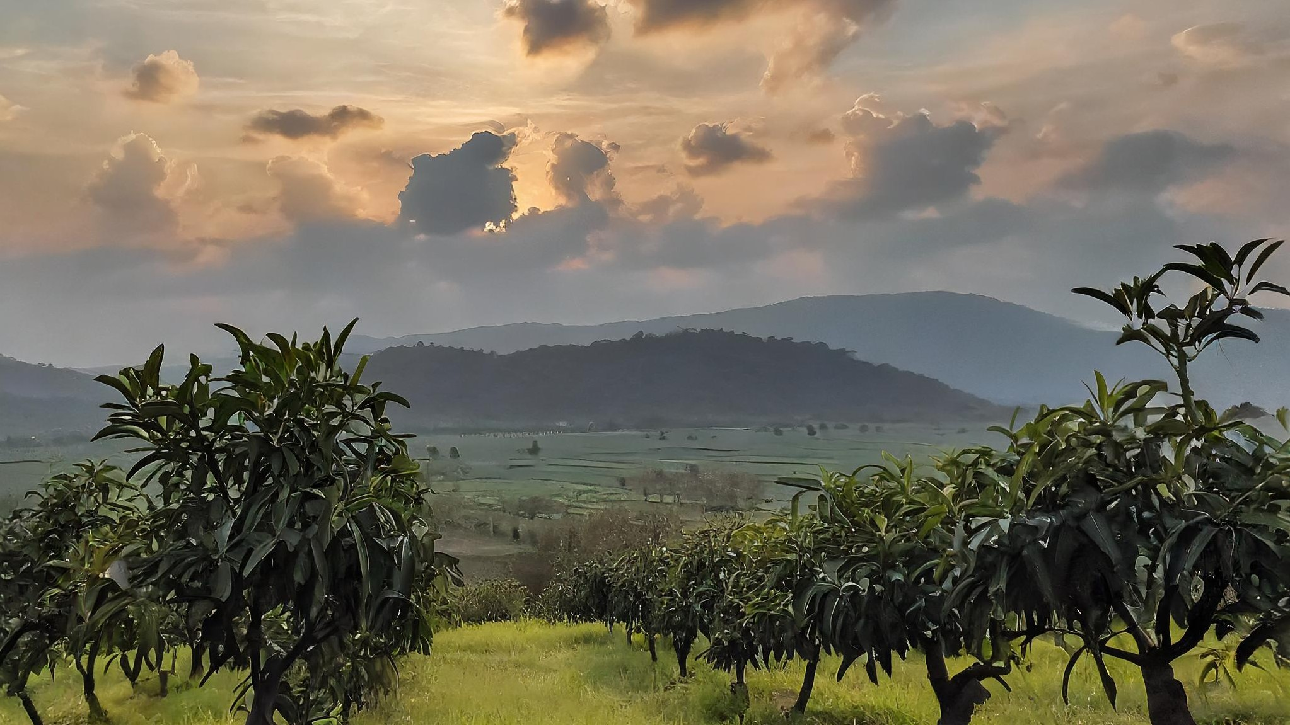
ESTIMATION OF BIOPHYSICAL CHARACTERISTICS USING MICROWAVE DATA AND MACHINE LEARNING
ESTIMATION OF BIOPHYSICAL CHARACTERISTICS USING MICROWAVE DATA AND MACHINE LEARNING

Slide 2
ESTIMATION OF BIOPHYSICAL CHARACTERISTICS USING MICROWAVE DATA AND MACHINE LEARNING
Introduction
ESTIMATION OF BIOPHYSICAL CHARACTERISTICS USING MICROWAVE DATA AND MACHINE LEARNING
Submitted by:
AKRITI DHYANI
ID: TS90723
MANISHA SHETTY
ID: TS90728
Submitted to:
Dr. Dipanwita Haldar
(Agriculture & Soils Department
Mr. Prasun Kumar Gupta
(Geoinformatics Department))
Market Importance: Siyana's mango orchards attract domestic and international demand due to high-quality mangoes.
Agricultural Optimization: Estimating biophysical parameters optimizes practices, predicts yields, and ensures sustainable management.
Remote Sensing Advancements: Microwave remote sensing revolutionizes large-scale parameter quantification.
SAR Data Integration: SAR data predicts biophysical parameters with reduced errors, enhancing management decisions.

Slide 3
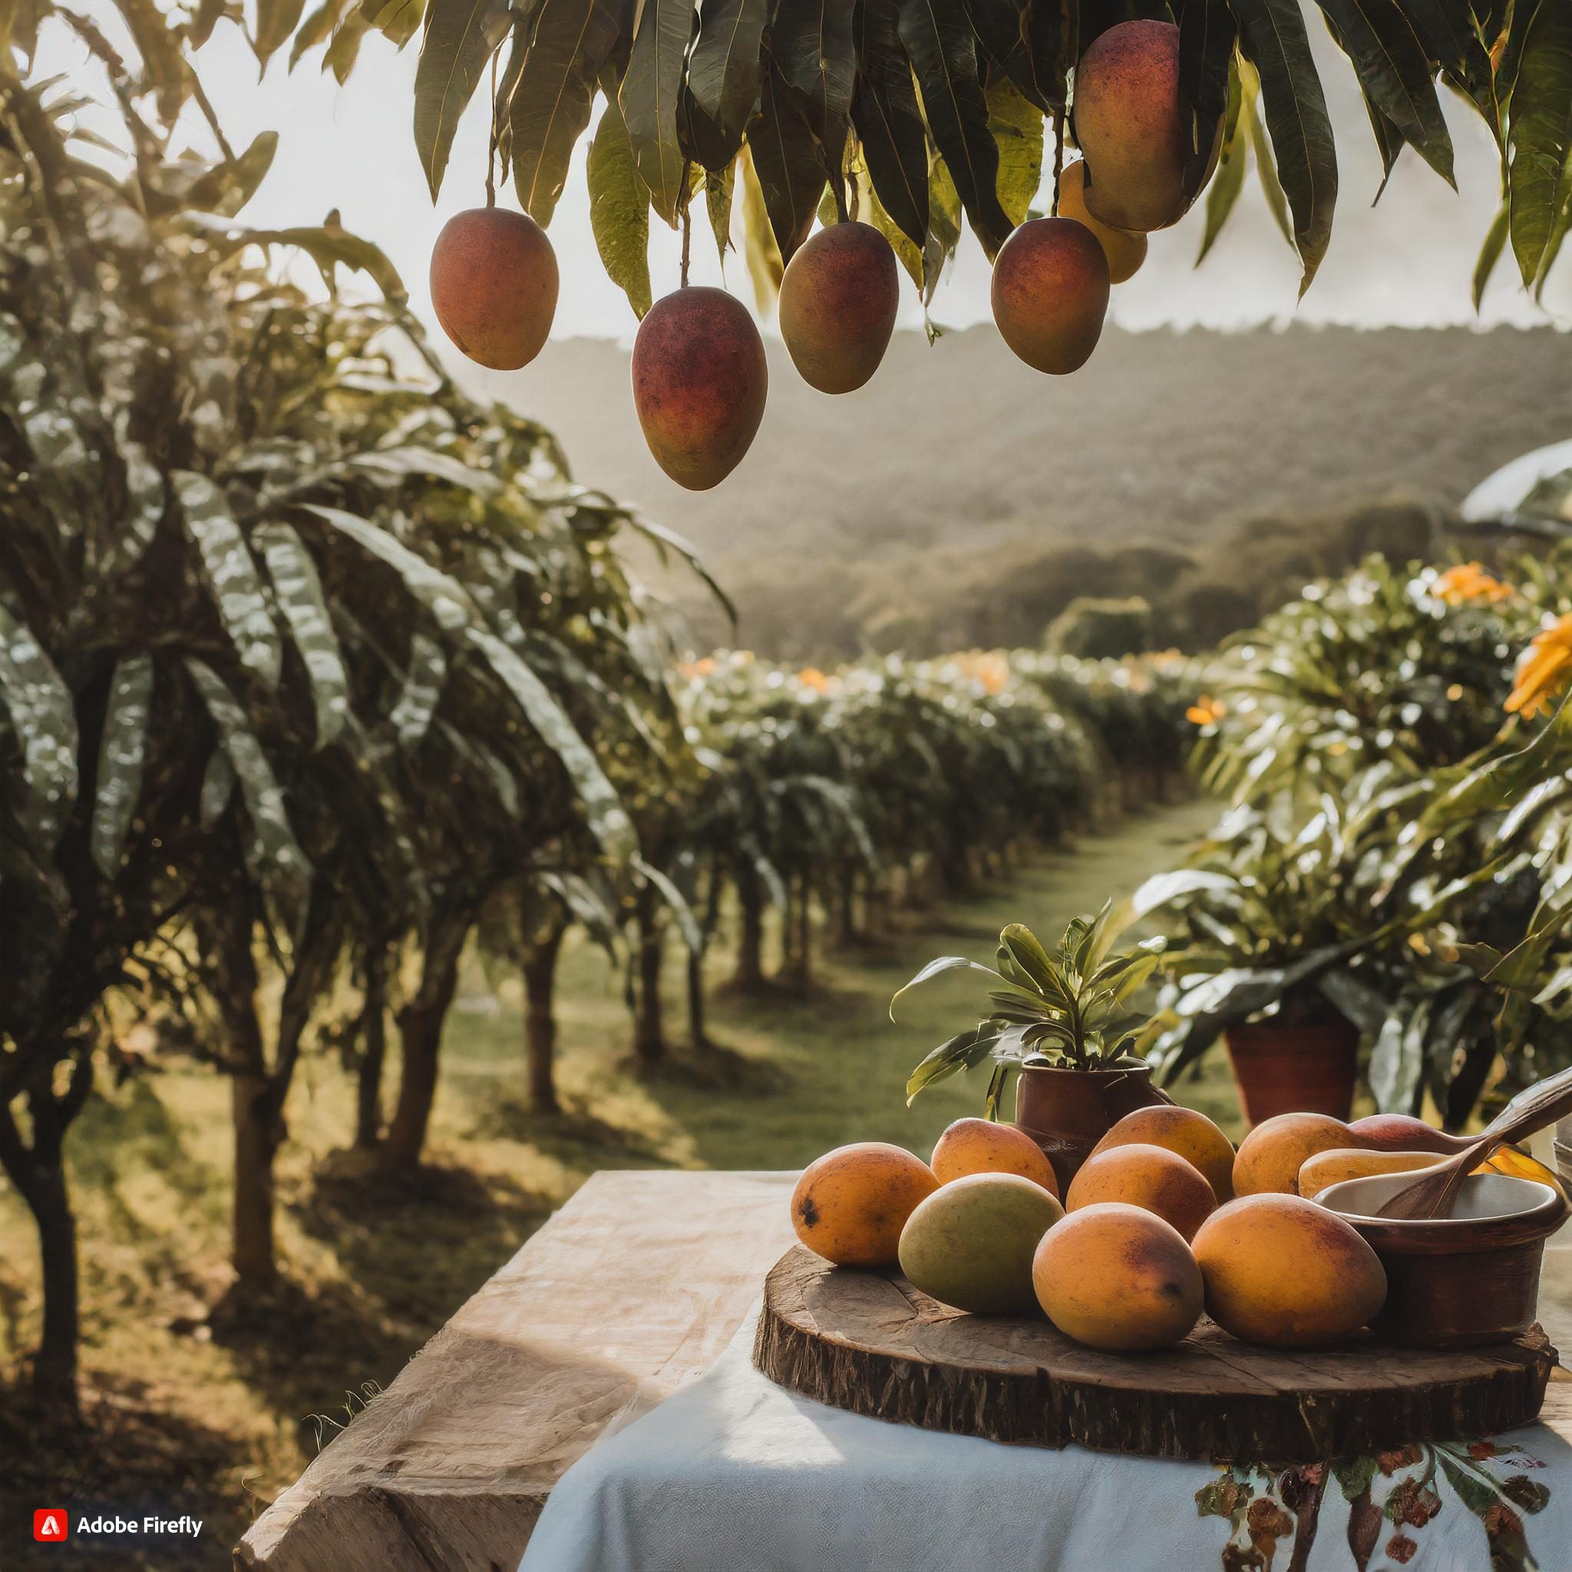
OBJECTIVES
Introduction
Market Importance: Siyana's mango orchards attract domestic and international demand due to high-quality mangoes.
Agricultural Optimization: Estimating biophysical parameters optimizes practices, predicts yields, and ensures sustainable management.
Remote Sensing Advancements: Microwave remote sensing revolutionizes large-scale parameter quantification.
SAR Data Integration: SAR data predicts biophysical parameters with reduced errors, enhancing management decisions.

Slide 4
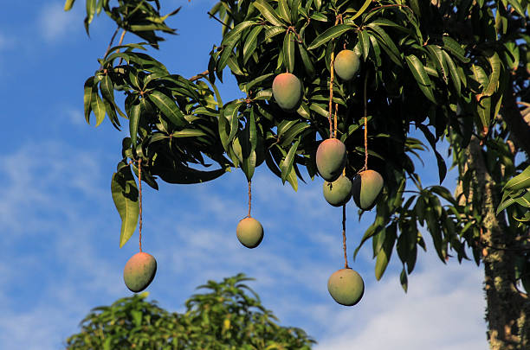
LITERATURE SURVEY AND GAP IN RESEARCH
Introduction
OBJECTIVES
OBJECTIVE 1:
To Assess the sensitivity of Mango tree biophysical parameters with Optical and SAR Indices.
OBJECTIVE 2:
To Develop Machine Learning Models for biophysical parameter retrieval using combination of SAR and Optical variables.
OBJECTIVE 3:
Generation of LAI, DBH, Orchard Height, Canopy Circumference predicted value Maps.
Biophysical characteristics encompass a wide range of parameters that describe the Earth's surface and its interactions with the atmosphere. These include but are not limited to soil moisture content, vegetation biomass, land surface temperature, and snow depth. Accurate estimation of these parameters is essential for various applications, including agriculture, hydrology, climate modeling, and natural resource management.
Traditional methods of estimating biophysical characteristics often rely on ground-based measurements, which are limited in spatial coverage and can be labor-intensive and costly. However, advancements in remote sensing technology, particularly in the domain of microwave remote sensing, have revolutionized our ability to observe and quantify these parameters over large areas and at frequent intervals.
Microwave remote sensing offers several advantages over optical remote sensing techniques. It is less affected by atmospheric conditions such as clouds, fog, and haze, allowing for all-weather and day-night observations. Moreover, microwaves can penetrate vegetation and soil, providing valuable information about subsurface properties and overcoming the limitations of optical sensors, which are typically hindered by surface reflectance.
Throughout this presentation, we will explore how the integration of microwave data and machine learning techniques facilitates the estimation of biophysical parameters at various spatial and temporal scales. We'll examine the underlying principles of microwave interaction with the Earth's surface, discuss the role of machine learning in environmental assessment, and showcase case studies highlighting successful applications of this approach.
Very few studies have been conducted to map mango orchards using Remote sensing. A study was conducted in 2014 which used high resolution data for generation of an inventory for orchards.
A review on the use of Sentinel-2 data for phenological studies state that very few studies have been carried out on the use of Red-Edge bands for phenological studies. Some studies have shown the potential of these bands require more research in this direction. To substantiate the capabilities of Sentinel-2 imagery for monitoring phenology, more studies must be carried out (Misra et al.,2020).
Debastiani et al. (2019) were one of the pioneers to use Sentinel-1 imagery to estimate above-ground biomass in the Amazon region, specifically in the Jamari National Forest, State of Rondônia, using not only SAR backscatter at VV and VH polarizations as well as texture metrics and the combination with vegetation indexes from Sentinel-2 optical data. The authors concluded that the use of Sentinel-1 C-band allowed to accurately quantify (RMSE = 23.9%) forest biophysical parameters, however, the integration of optical and texture data enabled an improvement in modeling when compared only with the SAR data, and the Random Tree algorithm was the model with best performance among the others evaluated.
SAR image is relevant for the modeling of aboveground biomass with errors inferior to 20%, demonstrating the potential of use of SAR data and techniques to estimate biomass of natural and planted forests when compared to field inventory only, optimizing the survey of information in large areas with acceptable precision (SANTOS et al., 2014).

Slide 5
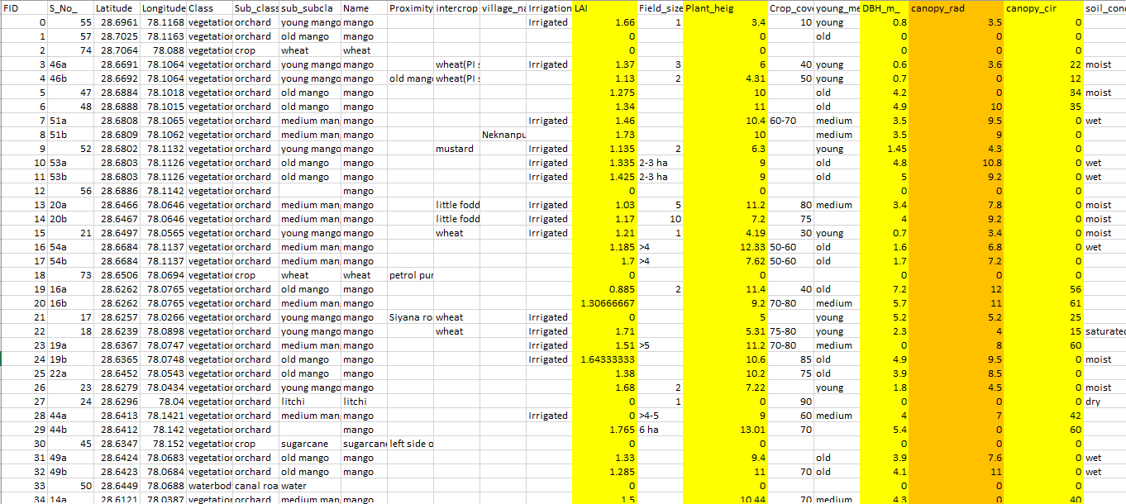
DATASET
METHODOLOGY CHART
OBJECTIVES
LITERATURE SURVEY AND GAP IN RESEARCH
OBJECTIVE 1:
To Assess the sensitivity of Mango tree biophysical parameters with Optical and SAR Indices.
OBJECTIVE 2:
To Develop Machine Learning Models for biophysical parameter retrieval using combination of SAR and Optical region.
The dataset, consisting of 96 rows and 29 columns, serves as the foundation for estimating biophysical parameters through Synthetic Aperture Radar (SAR) data analysis and Machine Learning (ML) techniques. It encompasses vital information such as geographical coordinates, land cover classifications, vegetation metrics like Leaf Area Index and Plant Height, and soil conditions. This dataset enables the development of robust models to accurately estimate biophysical parameters using SAR data and ML algorithms, fostering advancements in agricultural monitoring and land management practices.
OBJECTIVE 3:
Generation of Maps for visual interpretation of the predicted parameters.
Limited Mango Orchard Mapping Studies: Remote sensing studies on mapping mango orchards are scarce.
Misra, G., Cawkwell, F., & Wingler, A. (Year). Status of phenological research using Sentinel-2 data: A review.
Jesus, J. B., & Kuplich, T. M. (2020). Applications of SAR data to estimate forest biophysical variables in Brazil. Cerne, 26(1), 88-97.
Incorporation of ML Models.

Slide 6
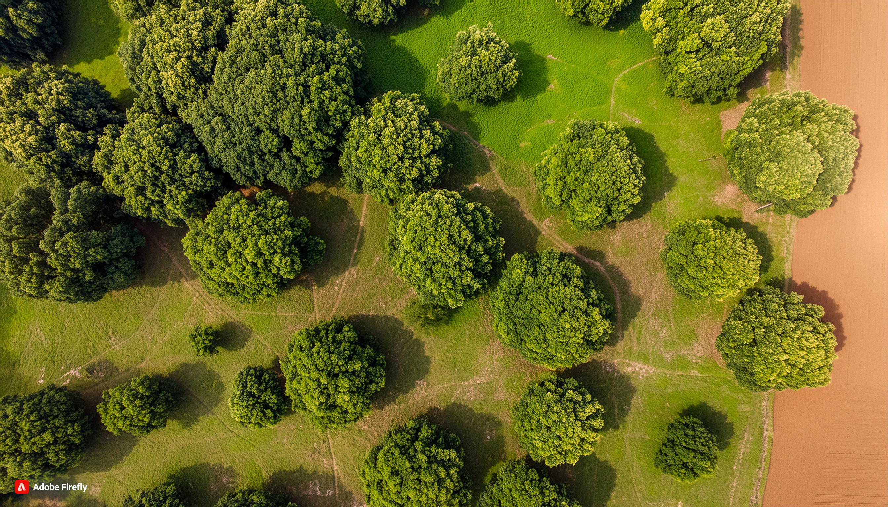
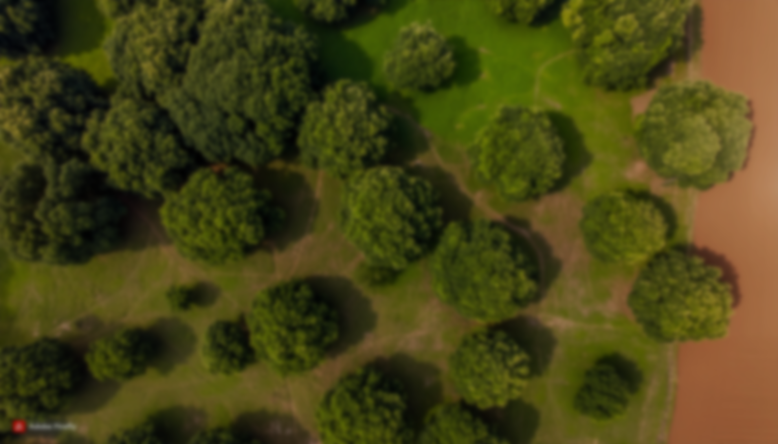
DATASET
96 rows, 29 columns
Geographical coordinates, land cover classifications, Biophysical parameters such as LAI, DBH, Orchard Height, Canopy Radius and Canopy circumference.

Slide 7
METHODOLOGY CHART
USED MACHINE LEARNING MODELS TO PREDICT THE BIOPHYSICAL PARAMETRS.
COMPUTING REQUIRED INDICES AND BACKSCATTER VALUES FROM GEE.
SELECTED BEST SUITABLE MODEL FOR EACH PARAMETER AND PREDICTED VALUES OF THAT PARTICULAR PARAMETER FOR CURRENT YEAR.
COMPUTED SCATTER PLOTS TO FIND CORRELATION BETWEEN DIFFERENT PARAMETER AND INDICES
REGRESSION ANALYSIS IN EXCEL
GENERATED MAP FOR PREDICTED VALUES USING ARCGIS.

Slide 8
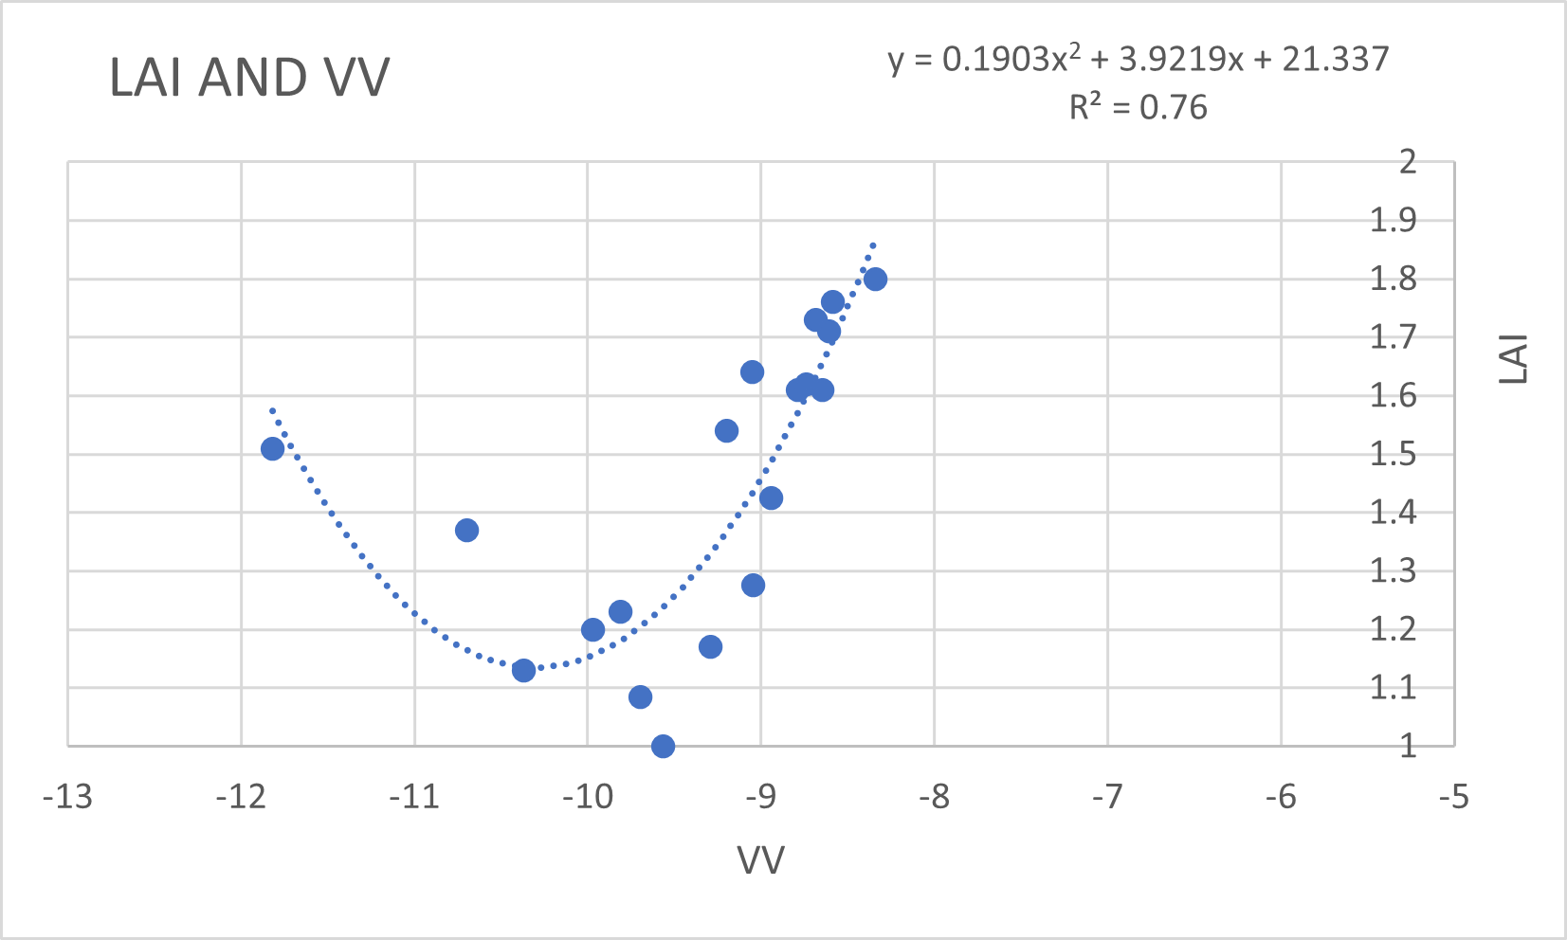

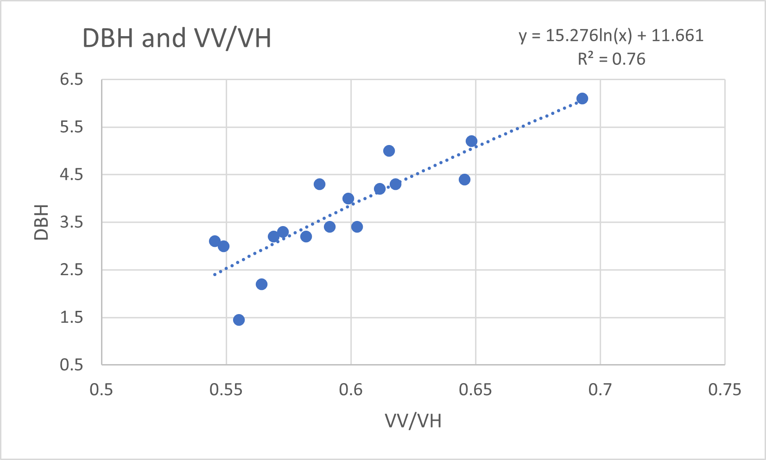
RESULT
OBJECTIVE 1:
Remote Sensing Variables and Biophysical Parameter Correlation Plots.
OBJECTIVE 2:
Machine Learning Model Observations.
OBJECTIVE 3:
LAI, DBH, Orchard height,
Canopy Circumference.

Slide 9
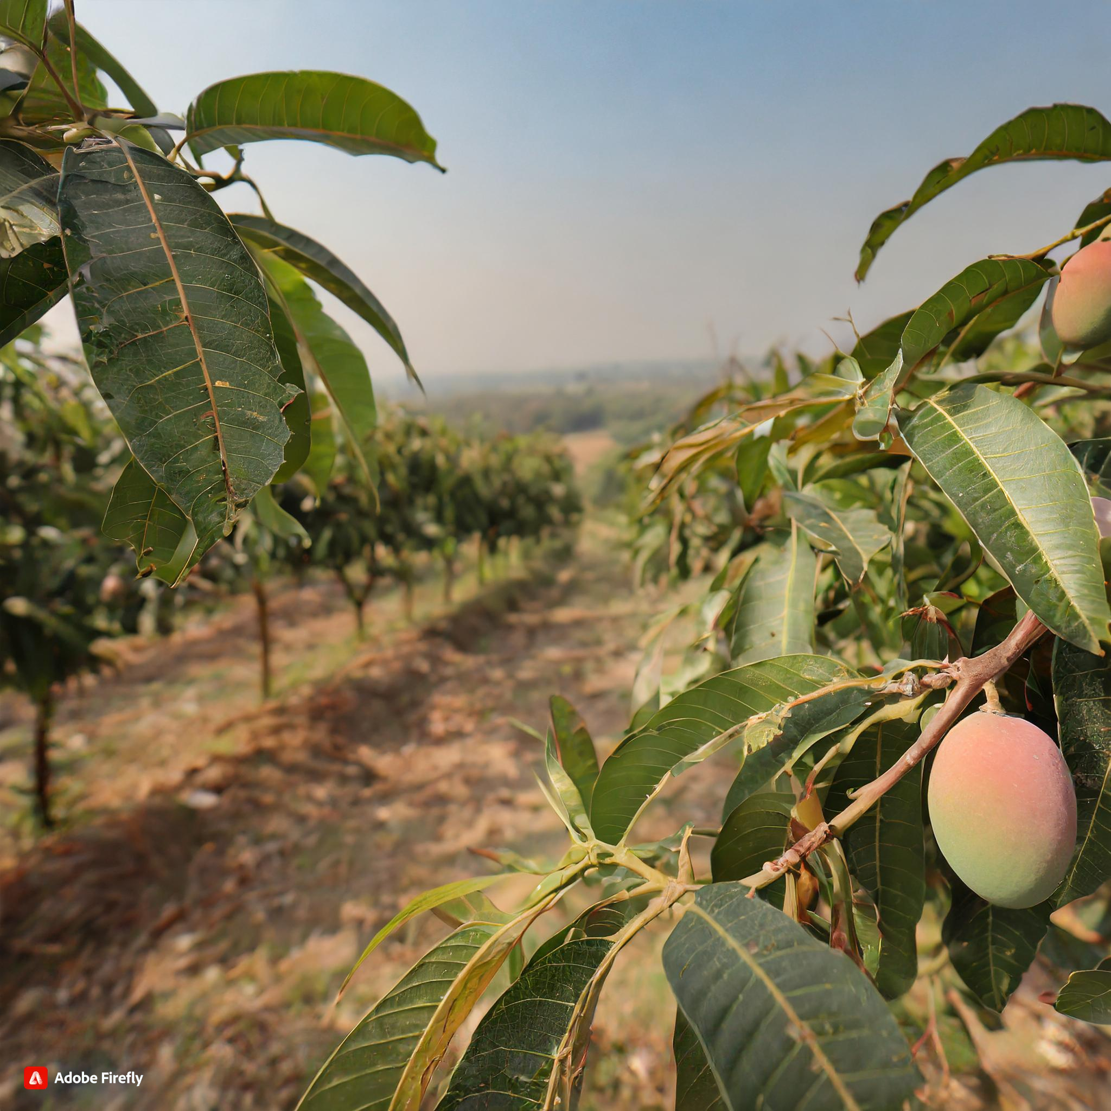
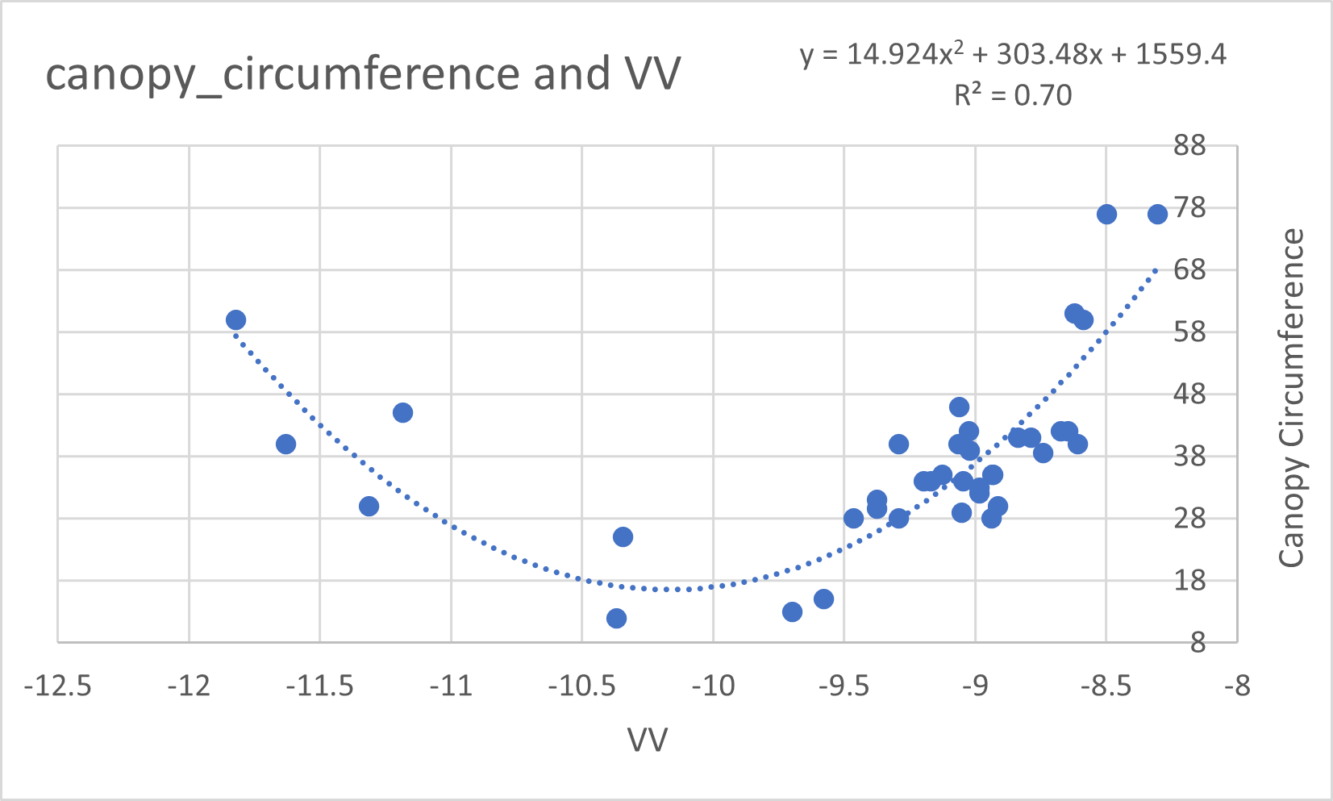
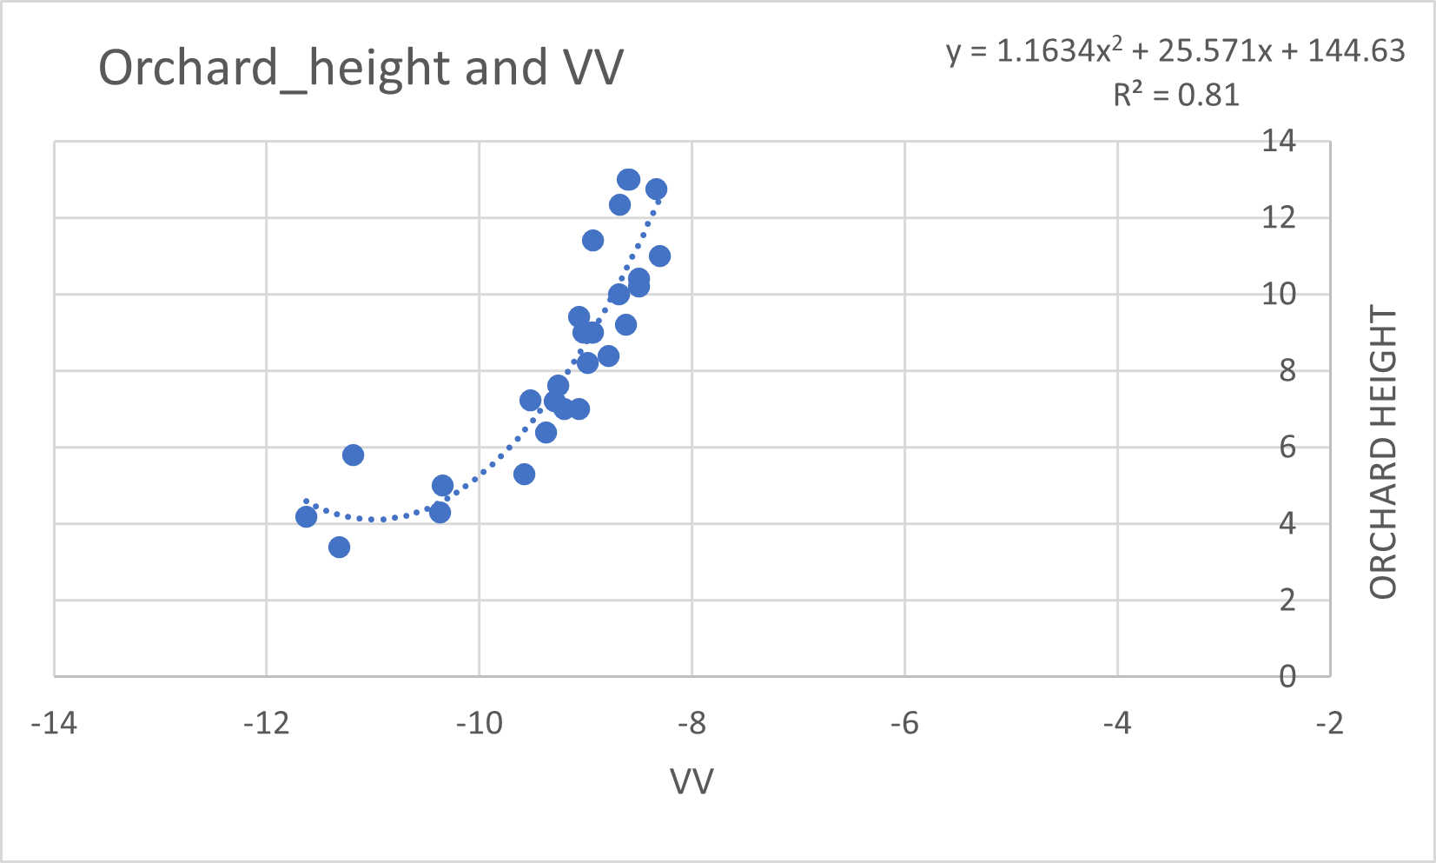
REMOTE SENSING VARIABLES AND BIOPHYSICAL PARAMETER CORRELATION PLOTS:

Slide 10
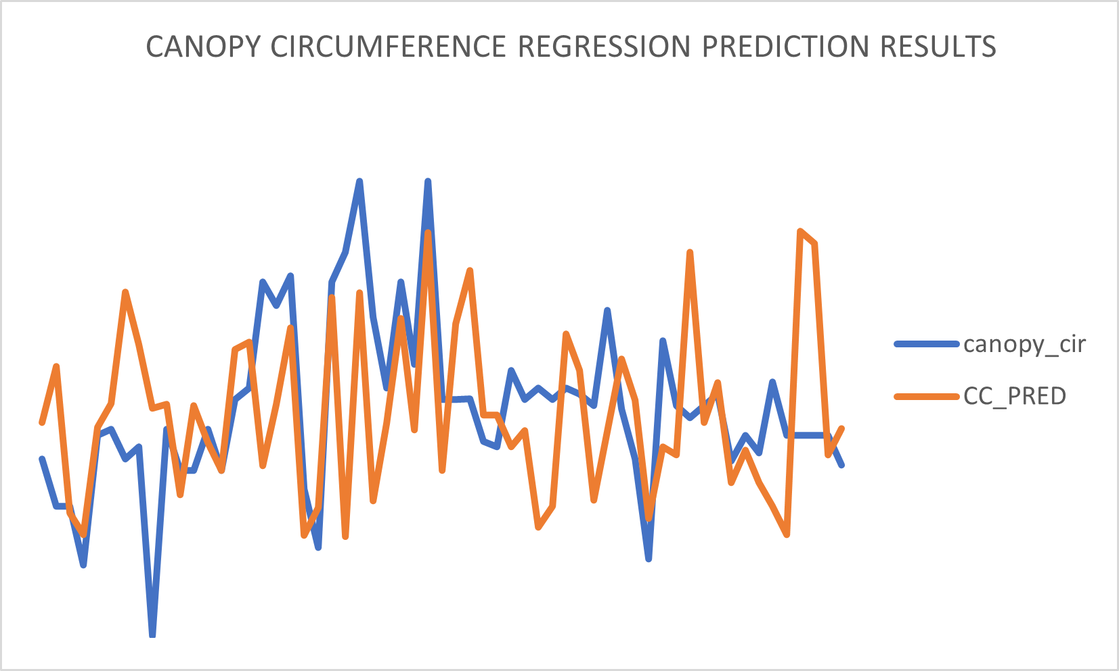
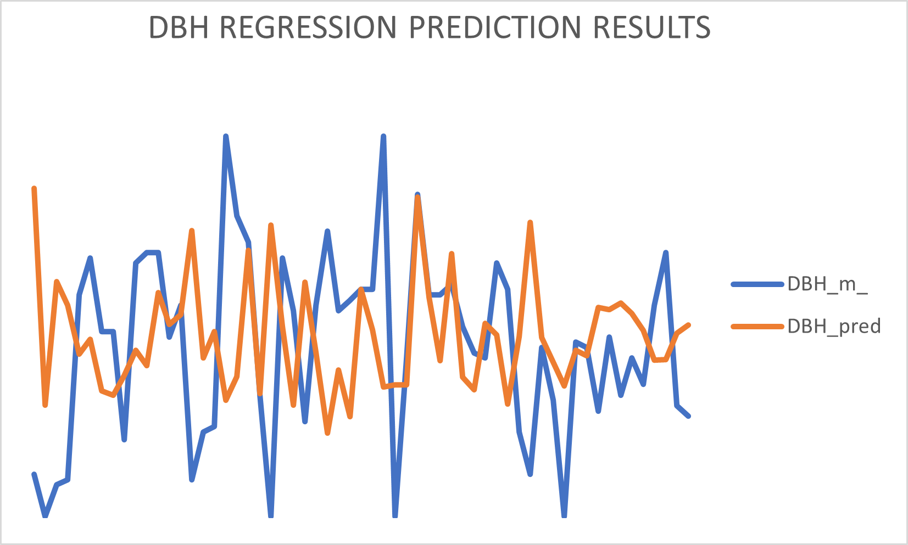
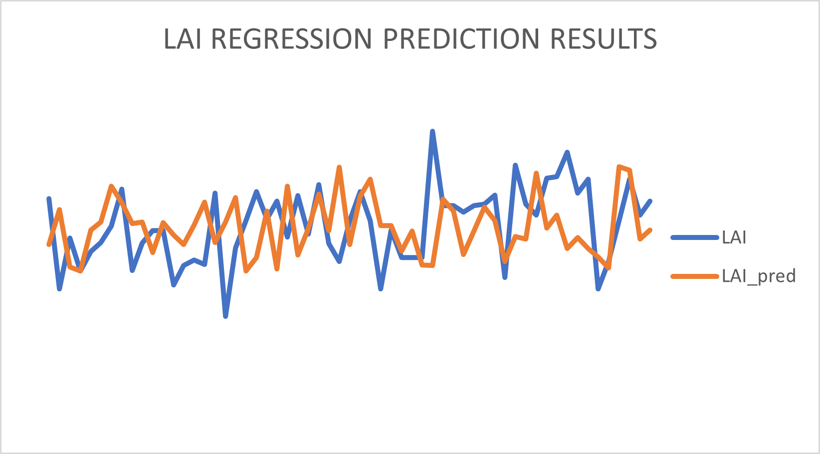
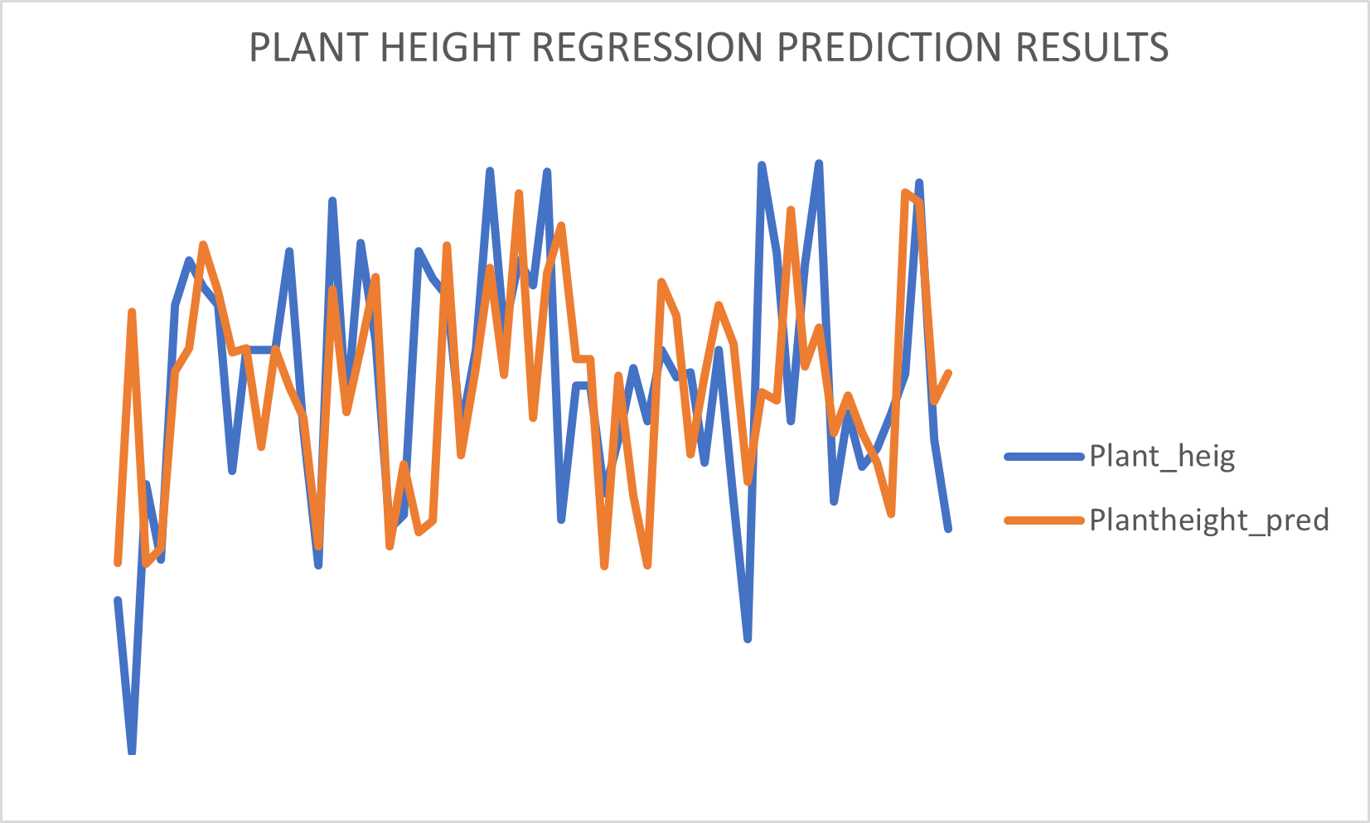
REMOTE SENSING VARIABLES AND BIOPHYSICAL PARAMETER CORRELATION PLOTS:

Slide 11
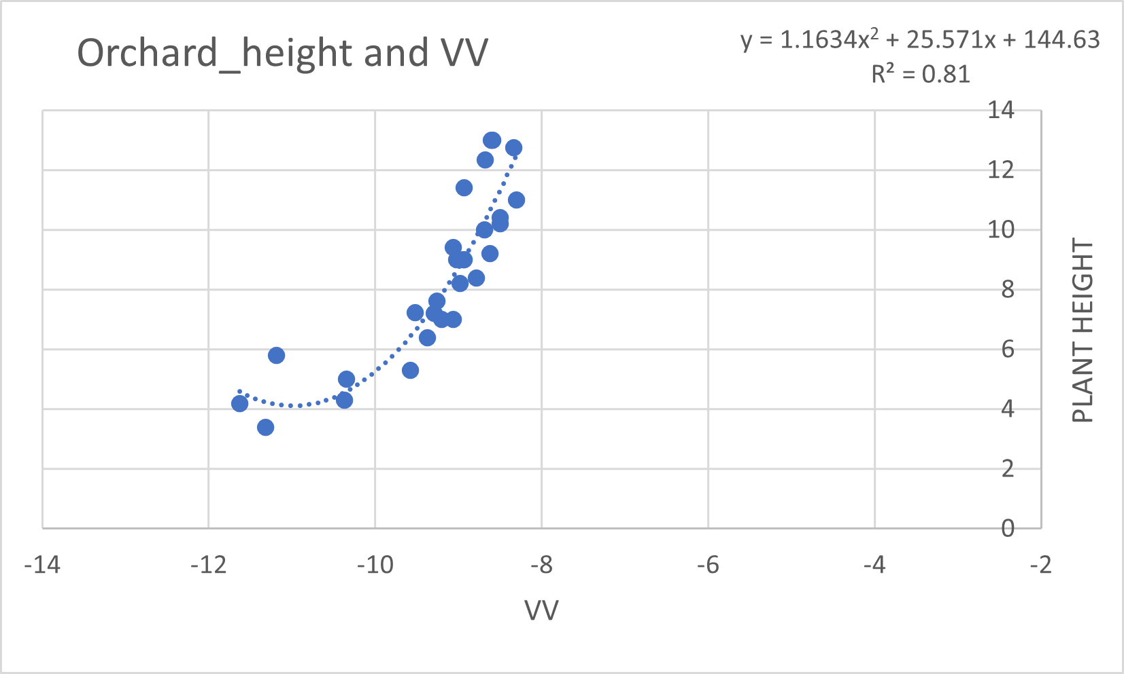
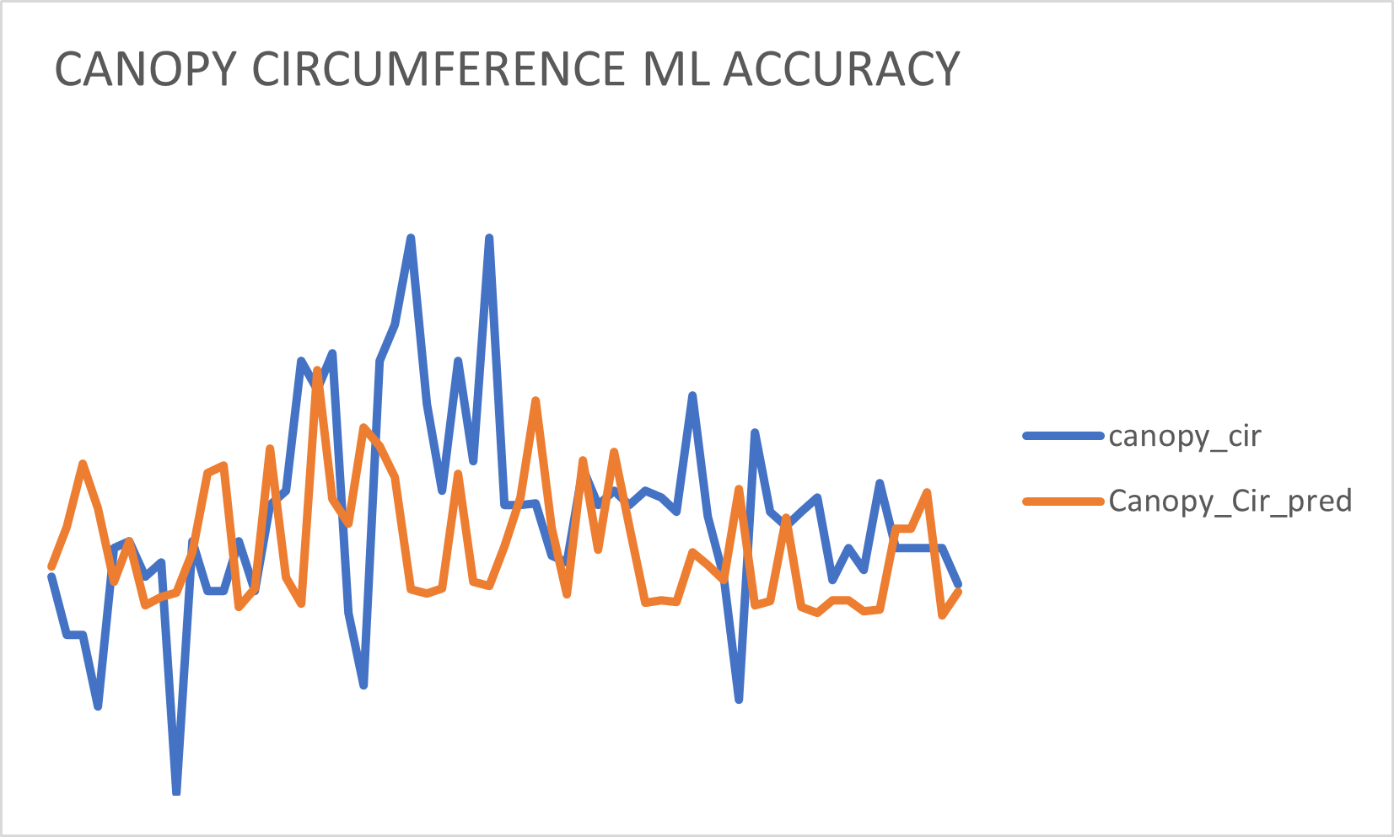
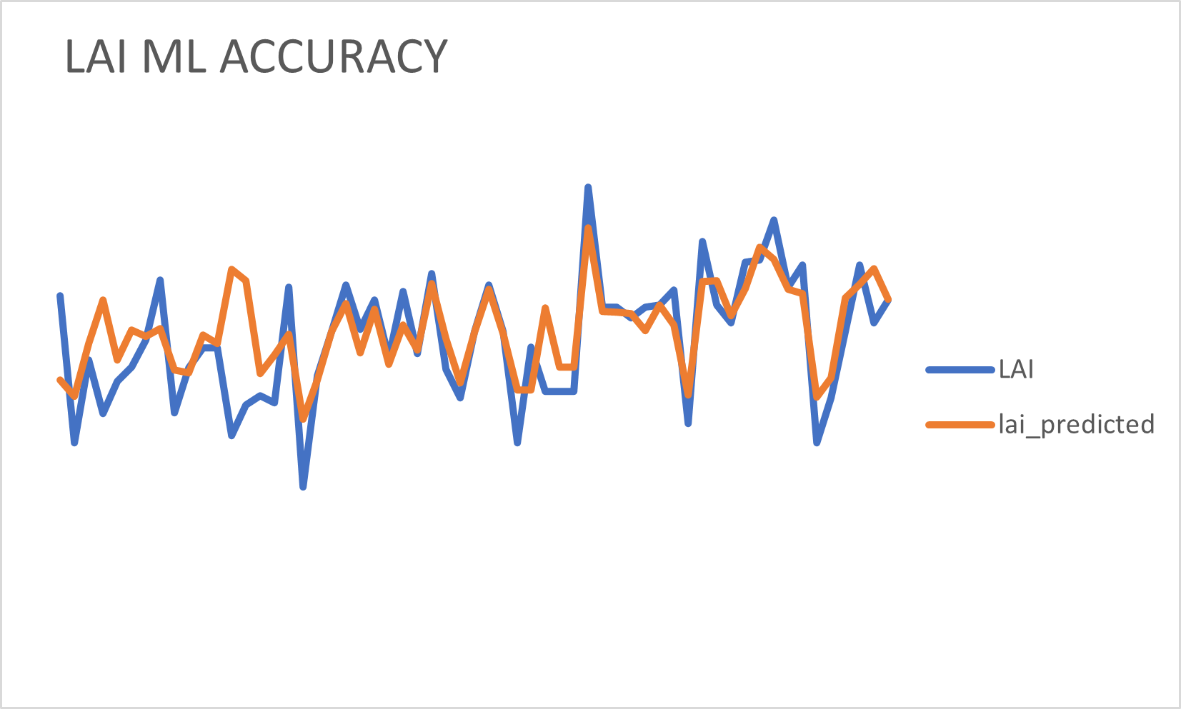
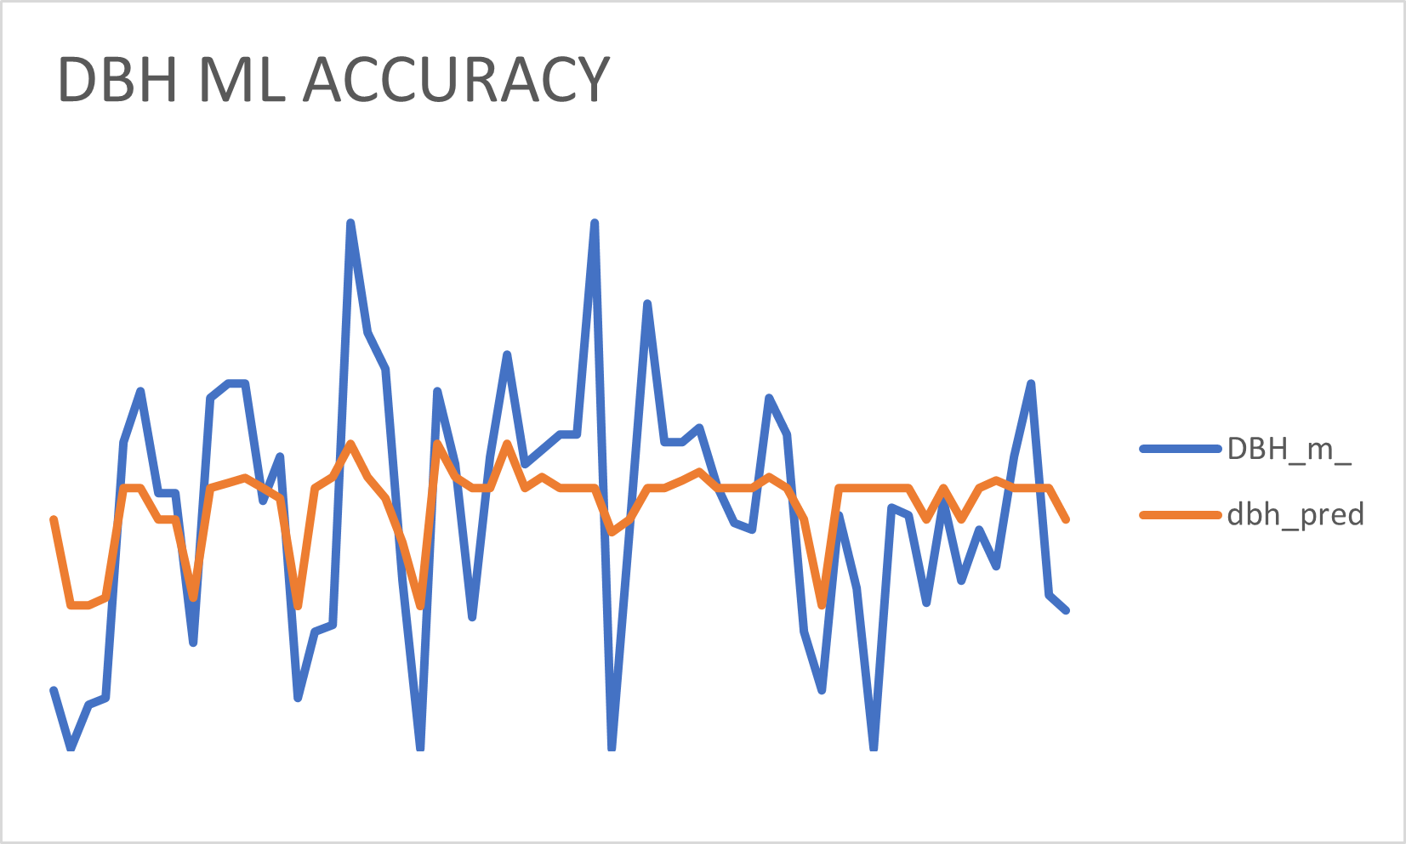
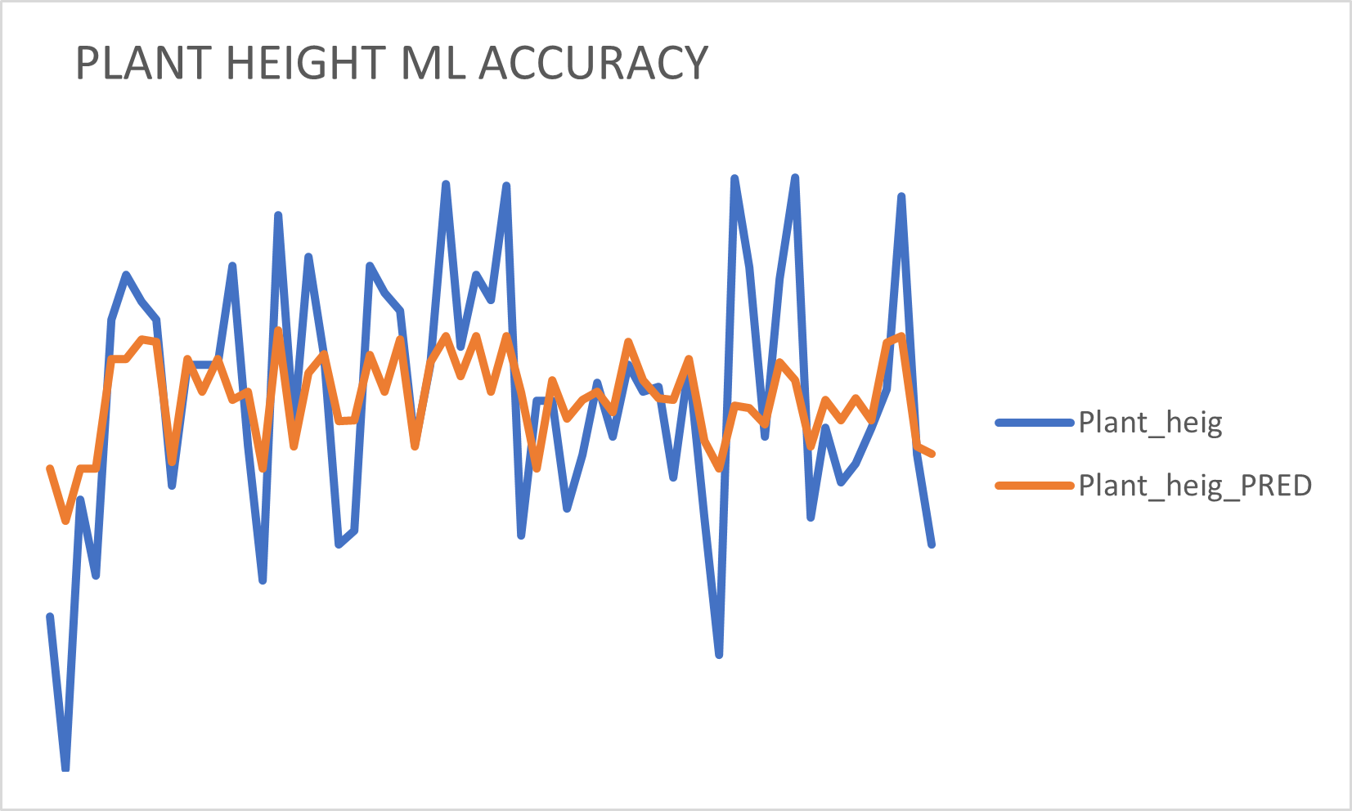
Regression Analysis Results

Slide 12
MODEL
INPUT VARIABLES
MAE
MAE(%)
RMSE
RMSE(%)
PARAMETER
LAI
RANDOM FOREST REGRESSOR
NDRE,NDVI
0.28
14.36%
0.36
18.2%
VV,VH
0.31
15.71%
0.38
19.37%
NDRE, NDVI
0.28
14.38%
0.34m
17%
ANN
VV, VH
0.28
14.45%
0.33m
16.5%
VH, Canopy Circumference
RANDOM FOREST REGRESSOR
VH, Canopy Circumference
23.38%
1.56m
RANDOM FOREST REGRESSOR
1.16m
23.38%
1.56m
DBH
1.16m
31.37%
31.37%
Orchard height, VH
Orchard height, VH
0.87 m
17.46%
1.21m
24.35%
VH, Canopy Circumference
0.93m
18.7%
1.34m
26.86%
ANN
Orchard height, VH
1.04m
20.88%
1.29m
25.93%

Slide 13
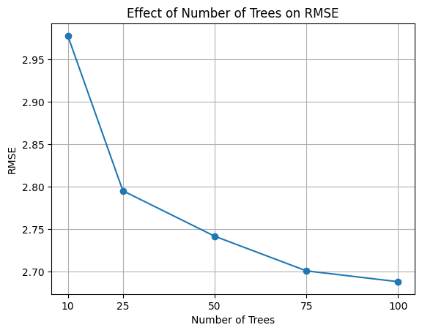
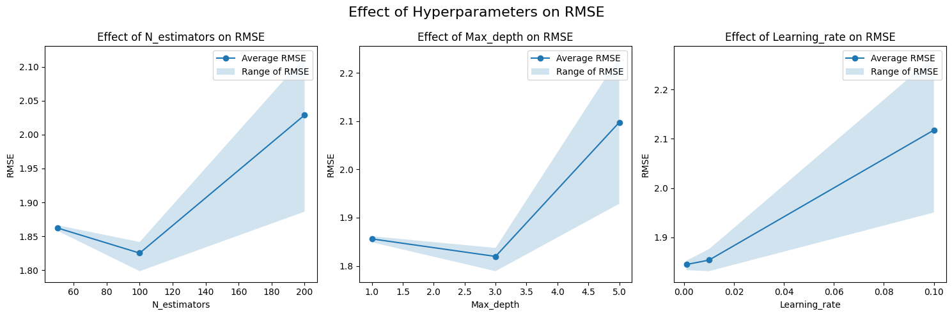
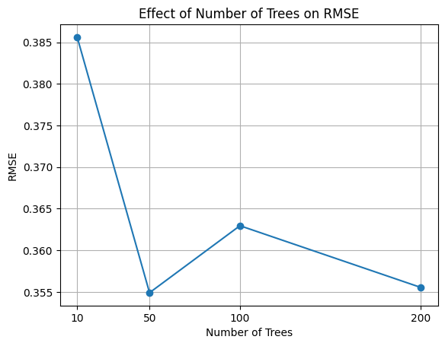
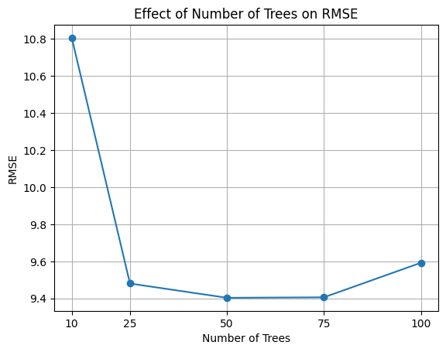
Effect of n-estimators on RMSE in RF for Orchard Height with input DBH and VH.
MODEL
INPUT VARIABLES
MAE
MAE(%)
RMSE
RMSE(%)
PARAMETER
The high correlation between canopy circumference and VV (vertical-vertical) polarization in mango orchards can be attributed to the structural characteristics of mango trees. Canopy circumference reflects the overall size and density of the canopy, while VV polarization is sensitive to the scattering properties of vegetation, including leaf orientation and canopy structure. In mango orchards, where tree canopies tend to be dense and vertically oriented, VV polarization is more likely to capture the canopy structure, leading to a strong correlation with canopy circumference.
Orchard height
RANDOM FOREST REGRESSOR
DBH,VV
2.24m
17.01%
2.68m
20.41%%
2.89m
21.9%
3.54m
26.88%
VV,VH
VV,VH
3.06m
23.34%
3.73m
28.37%
XGBOOST
VV,DBH
3.02m
22.9%
3.70m
28.11%
Canopy Circumference
RANDOM FOREST REGRESSOR
8.10m
14.73%
9.59m
DBH,VH
17.44%
10.40m
18.92%
13.58m
24.7%
RANDOM FOREST HYPERPARAMETER GRAPH
VV,VH
CANOPY CIRCUMDERENCE HYPERPARAMETER GRAPH
DBH,VH
8.86m
16.1%
11.24m
20.43%
ANN
VV,VH
12.06m
21.93%
16.41m
29.85%
Effect of n-estimators on RMSE in RF for Canopy Circumference with input DBH and VH.

Slide 14
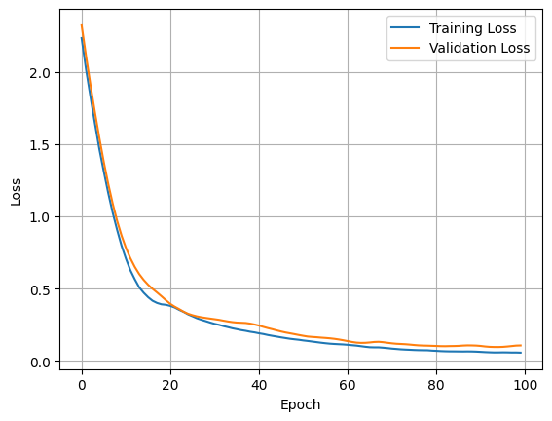
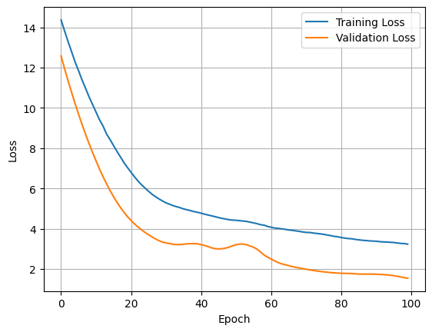
Effect of Epoch on Loss in ANN for LAI for Input VH and VV.
HYPERPARAMETER TUNING GRAPHS
Effect of n-estimators on RMSE in RF for Canopy Circumference with input DBH and VH.
Effect of n-estimators on RMSE in RF for Orchard Height with input DBH and VH.
Effect of Epoch on Loss in ANN for DBH for Input VH and Canopy Circumference.

Slide 15
Effect of Epoch on Loss in ANN for DBH for Input VH and Canopy Circumference.
Effect of Epoch on Loss in ANN for LAI for Input VH and VV.

Slide 16
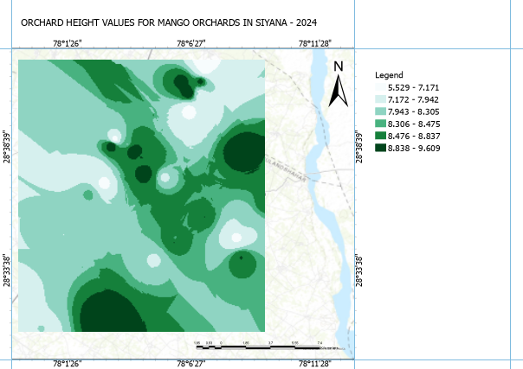
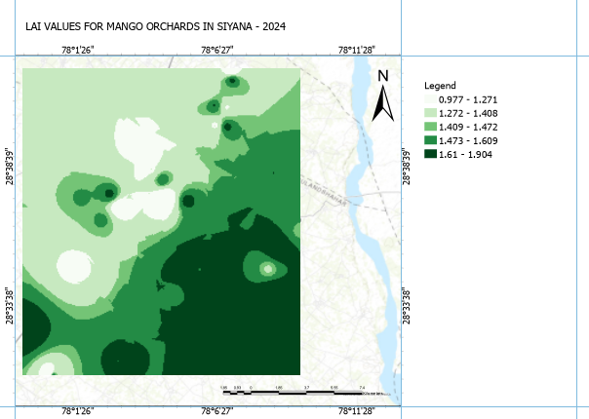
Effect of Epoch on Loss in ANN for LAI for Input VH and VV.
Machine Learning Result Plots
Effect of Epoch on Loss in ANN for DBH for Input VH and Canopy Circumference.

Slide 17
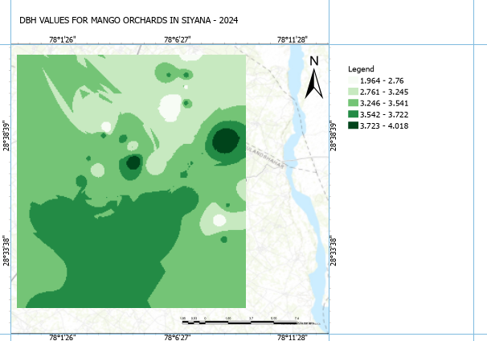
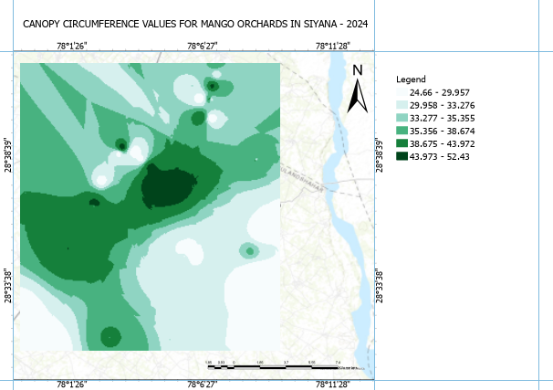
FINAL MAPS GENERATED USING PREDICTED VALUES:
LAI VALUES FOR MANGO ORCHARDS IN SIYANA
ORCHARD HEIGHT VALUES FOR MANGO ORCHARDS IN SIYANA

Slide 18
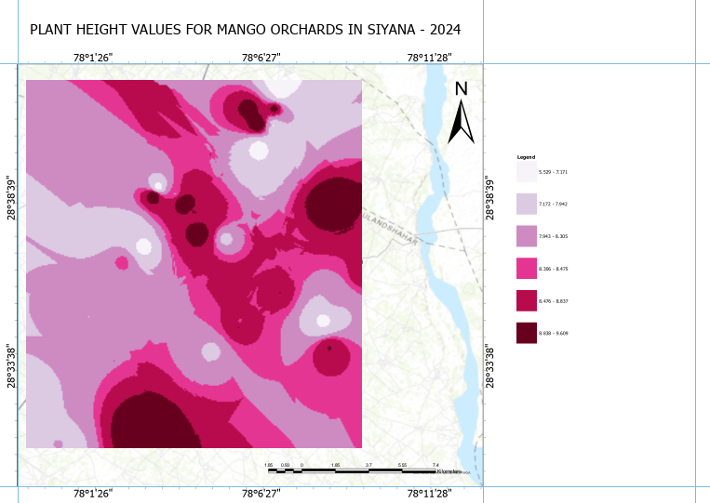
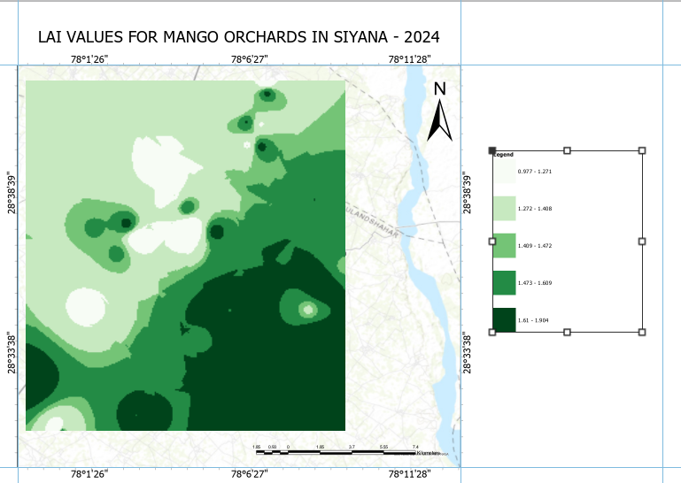
FINAL MAPS GENERATED USING PREDICTED VALUES:
DBH VALUES FOR MANGO ORCHARDS IN SIYANA
CANOPY CIRCUMFERENCE VALUES FOR MANGO ORCHARDS IN SIYANA

Slide 19
CONCLUSION:
SAR data derived parameter/indices are much more efficient in estimating the biophysical Parameters.
SAR derived parameter/indices combined with ML techniques surpasses traditional regression models.

Slide 20
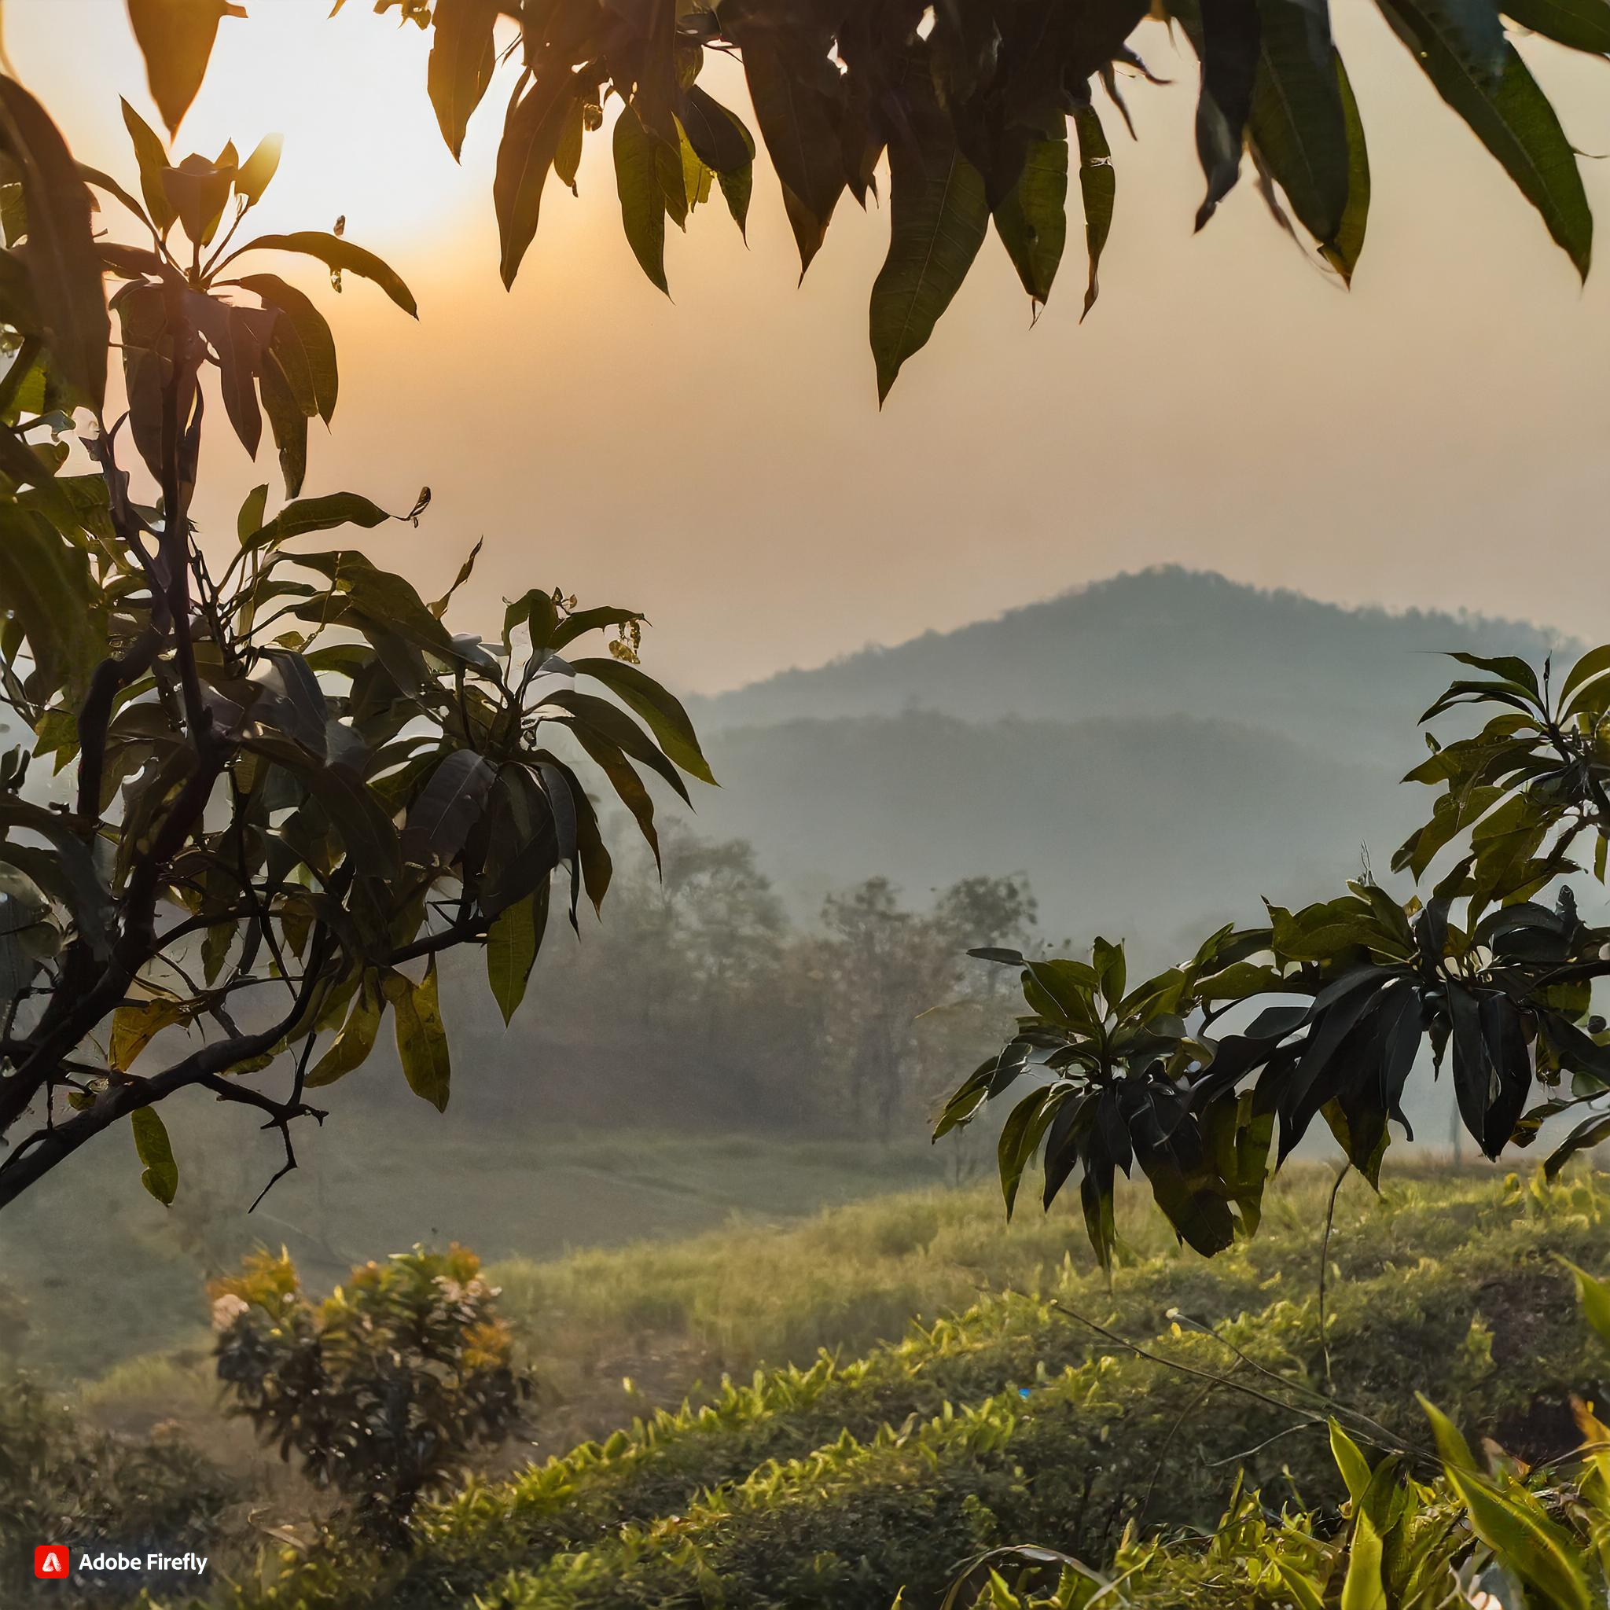
THANK YOU!

